Slide 1
BRANCH-AND-BOUND METHOD FOR INTEGER PROGRAMMING PROBLEMS
INTRODUCTION
It can be applied to solve the mixed , pure and Zero-one integer programming problems. This method first suggested by A.H. Land and A.G. Doig. This method partitions the area of feasible solution of LPP into smaller and smaller parts until an integer feasible solution is obtained Which optimizes the given objective function.

Slide 2
Branch-and-Bound Method
Basic Concepts
The basic concept underlying the branch-and-bound technique is to divide and conquer.
•Since the original “large” problem is hard to solve directly, it is divided into smaller and smaller sub problems until these sub problems can be conquered.
•The dividing (branching)is done by partitioning the entire set of feasible solutions into smaller and smaller subsets.
•The conquering (fathoming)is done partially by (i) giving a bound for the best solution in the subset;(ii) discarding the subset if the bound indicates that it can’t contain an optimal solution.

Slide 3
Steps in Branch-and-Bound Method for maximization ILP
Step1: Ignore the integer constraints in the given Integer Linear Programming problem and solve the resulting LPP using suitable linear programming Methods.
Step2: Examine the optimal solution of LP problem.
If the solution to the LPP is infeasible or unbounded, the solution to the given integer programming problem is also infeasible and unbounded, as the case may be
If the solution satisfy the integer restrictions, the optimal integer solution has been obtained, otherwise go to next step.
Step 3: Let the optimal value of objective function of LPP be Z₁. This value is an upper bound on objective function value. Find a feasible integer solution by rounding down each variable value. The objective function value associated with this solution is used as a lower bound on objective function value.

Slide 4
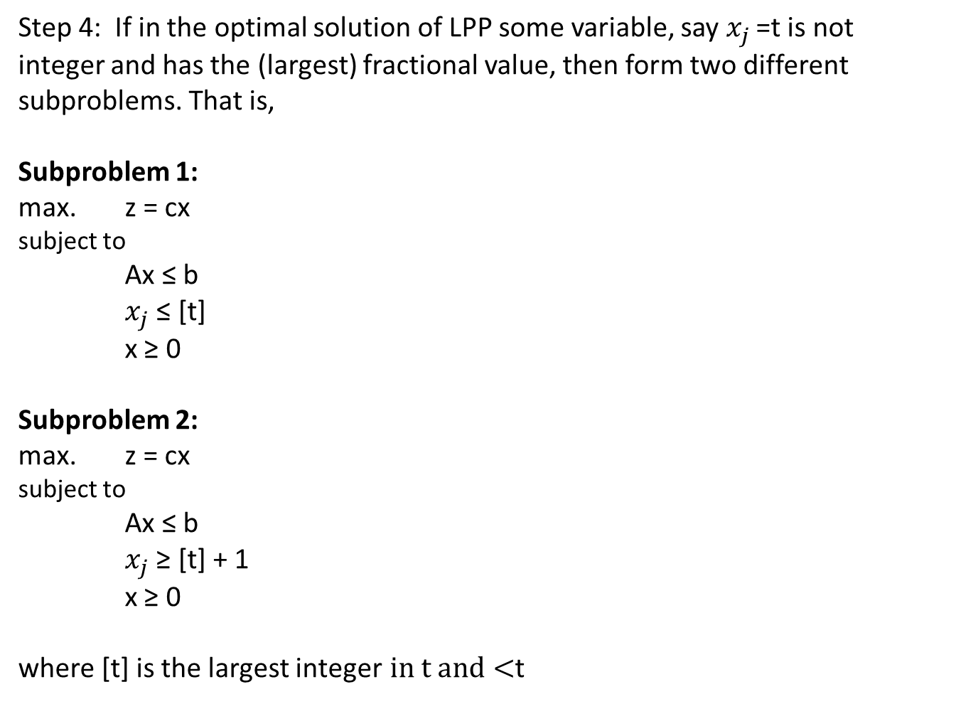
Step 4: If in the optimal solution of LPP some variable, say $x_{j }$=t is not integer and has the (largest) fractional value, then form two different subproblems. That is,
Subproblem 1: max. z = cx subject to Ax ≤ b $x_{j}$ ≤ [t] x ≥ 0
Subproblem 2: max. z = cx subject to Ax ≤ b $x_{j}$ ≥ [t] + 1 x ≥ 0 where [t] is the largest integer$in t and<$t

Slide 5
Step5: solve the sub problems 1 and 2 and examine the optimal solutions of both sub problems. Let the maximum value of Z of subproblem 1 is Z₁ and that of subproblem 2 is Z₂. The best integer solution value becomes the lower bound on the integer LP problem objective function value. Let the lower bound be denoted by Z_{L}.
Step6:
If a sub problem yields a solution that is not feasible, this sub problem is said to be fathomed, meaning that it need not be investigated any further because it cannot yield any better ILP solution.
If a sub problem yields a solution that is feasible, but not an integer solution, go to step 3.
If the sub problem yields a feasible integer solution, look at the objective function value. If its value equals the upper bound, an optimal solution has been reached. But if it is not equal to the upper bound, but exceeds the lower bound, set it as the new upper bound and go to step 3. Finally, if it is less than the lower bound, this sub problem is fathomed.

Slide 6
Step7:
The procedure of branching and bounding continues until no further sub problem remains to be examined.
At this stage, the integer solution corresponding to the current lower bound is the Optimal integer programming problem solution.

Slide 7
Example 1
Consider the following problem
Max Z= 2x₁+ 3x₂
Subject to
6x₁+ 5x₂ ≤25
x₁+ 3x₂ ≤10
x₁, x₂ ≥0 and integers

Slide 8
Step 1: Ignoring the integer conditions, solve the above problem by graphical method
6x₁+5x₂=25
(0,5)
Optimal non-integer solution
(x₁=1.92, x₂=2.69, and Z=11.91)
(0,10/3)
Feasible
Region
x₁+3x₂=10
(25/6,0)

Slide 9
Step 2: Upper bound of Z is 11.91 (x₁=1.92, x₂=2.69)
Lower bound of Z is 7 (x₁=1, x₂=2)
Step 3:Since the solution is non integer, $x_{2 }$is selected
Max Z= 2x₁+ 3x₂
Subject to
6x₁+ 5x₂ ≤ 25
x₁+ 3x₂ ≤ 10
x₂ ≤ 2
x₁, x₂ ≥0
Sub-problem B
Max Z= 2x₁+ 3x₂
Subject to
6x₁+ 5x₂ ≤ 25
x₁+ 3x₂ ≤ 10
x₂ ≥ 3
x₁, x₂ ≥0
Sub-problem C

Slide 10
Step 4:
The optimal feasible solutions of subproblems are :
Optimal solution
(x₁=1, x₂=3)
6x₁+5x₂=25
C
x₂=3
x₂=2
B
x₁+3x₂=10
Sub-problem B : x₁ =2.5, x₂=2, Max Z = 11
Sub-problem C : x₁ =1, x₂=3, Max Z = 11

Slide 11
Step 2: Upper bound of Z is 11 (x₁=2.5, x₂=2)
Lower bound of Z is 11 (x₁=1, x₂=3)
Step 3: Since UB of Z is not less than LB, Sub Problem 1 is divided into further sub problems
Max Z= 2x₁+ 3x₂
Subject to
6x₁+ 5x₂ ≤ 25
x₁+ 3x₂ ≤ 10
x₂ ≤ 2
x₁ ≤ 2
x₁, x₂ ≥0 and integers
Sub-problem D
Max Z= 2x₁+ 3x₂
Subject to
6x₁+ 5x₂ ≤ 25
x₁+ 3x₂ ≤ 10
x₂ ≥ 3
x₁ ≥ 3
x₁, x₂ ≥0 and integers
Sub-problem E

Slide 12
Step 4:
The optimal feasible solutions of sub problems are :
Optimal solution
(x₁=1, x₂=3, Max Z=11)
6x₁+5x₂=25
Optimal solution
(x₁=2, x₂=2, Max Z=11)
C
x₂=3
Optimal solution
(x₁=3, x₂=1.4, Max Z=10.2)
x₂=2
D
E
x₁+3x₂=10
x₁=2
x₁=3
Sub-problem D : x₁ =2, x₂=2, Max Z = 10
Sub-problem E : x₁ =3, x₂=1.4, Max Z = 10.2

Slide 13
Step 2: Upper bound of Z is 10.2 (x₁=3, x₂=1.4)
Lower bound of Z is 11 (x₁=1, x₂=3)
Since the upper bound is less than the Lower bound, the sub problem 4 is fathomed.
Since the solution of sub problem 3 is integer, the sub problem 3 is fathomed. TERMINATE the process.
Hence, the optimal solution of the given integer programming problem is the solution corresponding to sub problem 2.
That is, x₁=1, x₂=3, Z=11

Slide 14
The history of the complete branch and bound solution is displayed by means of the following tree like diagram.
X₁=1.92, X₂=2.69, Z₁=11.92
X₁=1, X₂=3, Z₂=11
X₁=2.5, X₂=2, Z₃=11
X₁=2, X₂=2, Z₄=10
X₁=3, X₂=1.4, Z₄=10.2
C
Optimal solution
x₂≥3
A
D
X₂ ≤2
B
X₁ ≤2
E
x₁≥3

Slide 15
Example 2 (Branch-and-Bound Method)
Maximize profit = 7.00 X1 + 6.00 X2
subject to:
2X1 + 3X2 =< 12 ( wiring hours )
6X1 + 5X2 =< 30 ( assembly hours )
X1, X2 => 0 and integers
where:
X1 = number of chandeliers produced
X2 = number of ceiling fans produced
The optimal solution is X1 = 3.75 chandeliers and X2 = 1.5 ceiling fans

Slide 16
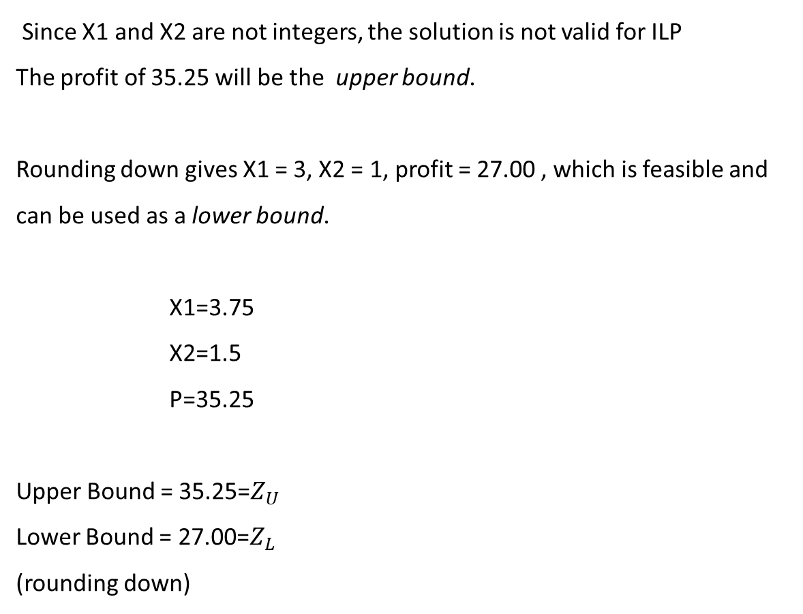
Since X1 and X2 are not integers, the solution is not valid for ILP
The profit of 35.25 will be the upper bound.
Rounding down gives X1 = 3, X2 = 1, profit = 27.00 , which is feasible and can be used as a lower bound.
X1=3.75
X2=1.5
P=35.25
Upper Bound = 35.25=$Z_{U}$
Lower Bound = 27.00=$Z_{L}$
(rounding down)

Slide 17
We divide the problem into two sub problems, A and B
We Select the variable X1 for branching the LPP into two new LP sub problems because it has the largest fractional value
Sub problem A
Max Z = 7X1 + 6X2
s.t.
2X1 + 3X2 =< 12
6X1 + 5X2 =< 30
X1 => 4
X1=4
X2=1.2
P=35.20
Noninteger Solution
Upper Bound = 35.20
Lower Bound = 33.00
Sub problem B
Max Z = 7X1 + 6X2
s.t.
2X1 + 3X2 =< 12
6X1 + 5X2 =< 30
X1 =< 3
X1=3
X2=2
P=33.00
Solution Is Integer
New Lower Bound = 33.00

Slide 18
Sub problem A is now branched into two new subproblems, C and D
Sub problem C has the additional constraint of X2 => 2
Sub problem D has the additional constraint of X2 =< 1
The logic here is that since A’s optimal solution of X2 = 1.2 is not integer, the integer feasible answer must lie at X2 => 2 or X2 =< 1
Sub problem C
Max Z = 7X1 + 6X2
s.t.
2X1 + 3X2 =< 12
6X1 + 5X2 =< 30
X1 => 4
X2 => 2
Subproblem C has no feasible solution
Sub problem D
Max Z = 7X1 + 6X2
s.t.
2X1 + 3X2 =< 12
6X1 + 5X2 =< 30
X1 => 4
X2 =< 1
X1=4.17
X2=1
P=35.16
Upper Bound = 35.16
Lower Bound = 33.00

Slide 19
We Branching the sub problem D into two new sub problems E and F and solve for X1 and X2 with the additional constraints X1 =< 4 and X1 => 5 .
Sub problem E
Max Z = 7X1 + 6X2
s.t.
2X1 + 3X2 =< 12
6X1 + 5X2 =< 30
X1 => 4
X1 =< 4
X2 =< 1
Sub problem F
Max Z = 7X1 + 6X2
s.t.
2X1 + 3X2 =< 12
6X1 + 5X2 =< 30
X1 => 4
X1 => 5
X2 =< 1
X1=4
X2=1
P=34.00
Feasible
Integer
Solution
Feasible
Integer
Optimal
Solution
X1=5
X2=0
P=35.00

Slide 20
Example 3 :(Branch-and-Bound Method)
Maximize z = x₁ + x₂
subject to 3x₁ + 2x₂ ≤ 12 x₂ ≤ 2
x₁, x₂ ≥ 0 are integers

Slide 21
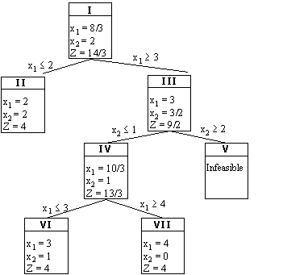
The history of the complete branch and bound solution is displayed by means of the following tree like diagram.

Slide 22
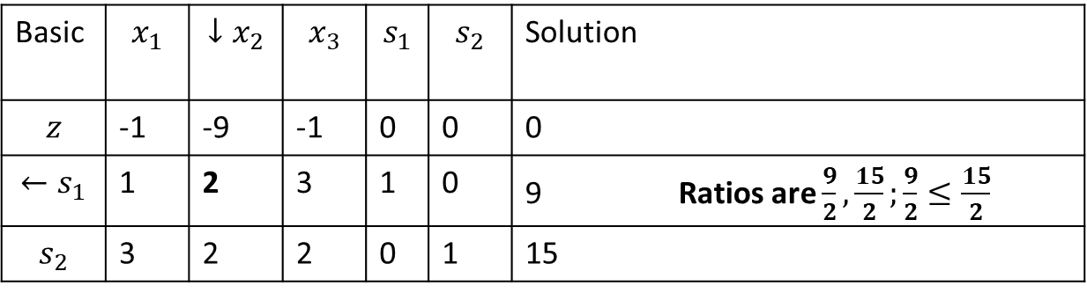
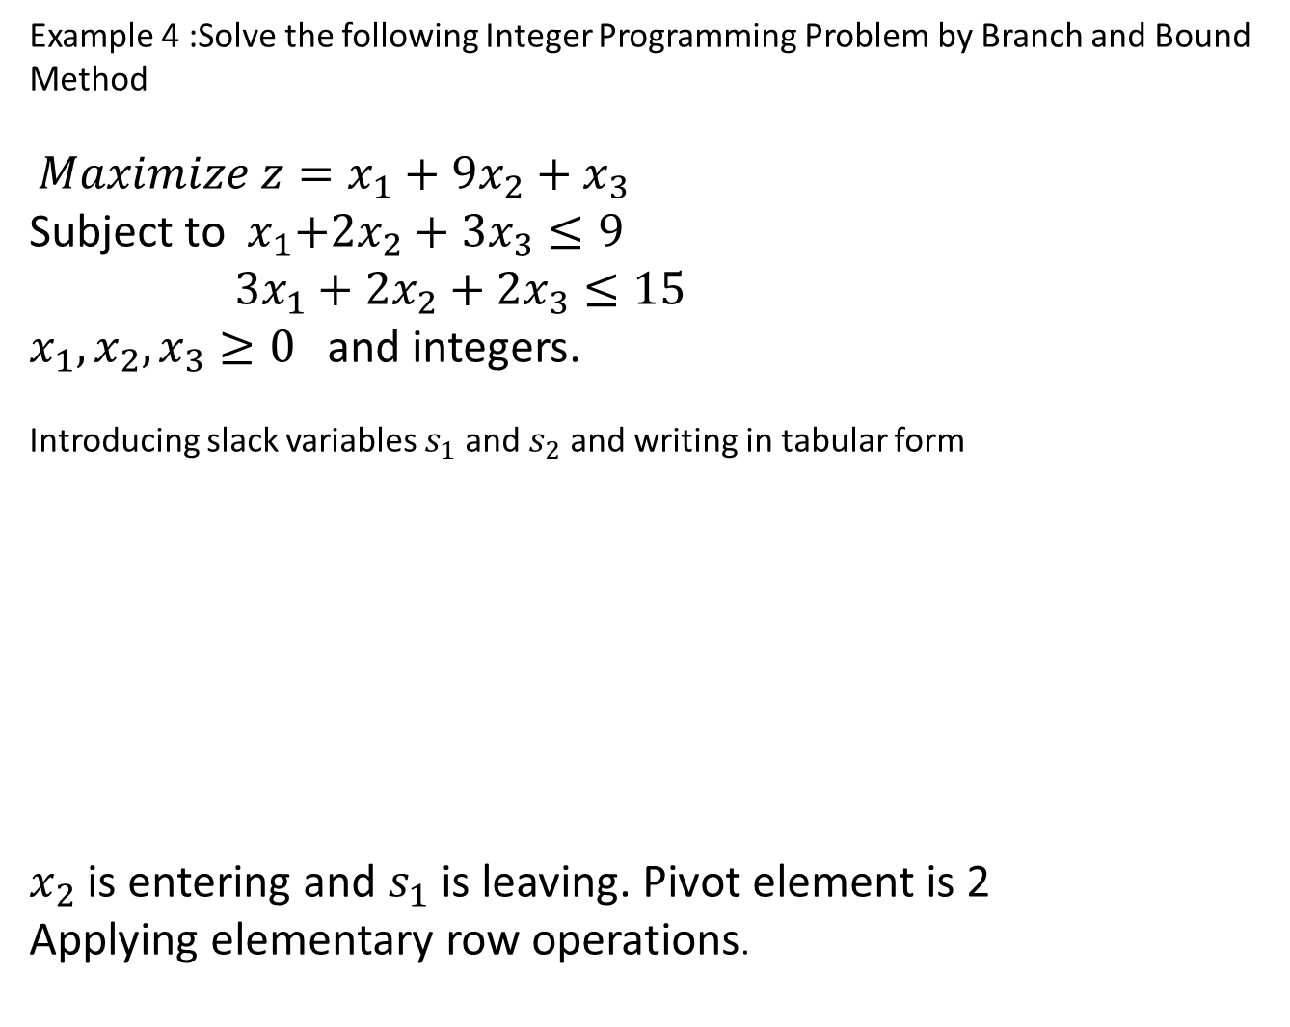
Example 4 :Solve the following Integer Programming Problem by Branch and Bound Method
$Maximize z=x_{1}+9x_{2}+x_{3}$
Subject to ${ x}_{1}+2x_{2}+3x_{3}≤9$
$3x_{1}+2x_{2}+2x_{3}≤15$
$x_{1},x_{2},x_{3}≥0$ and integers.
Introducing slack variables $s_{1}$ and $s_{2}$ and writing in tabular form
$x_{2}$ is entering and $s_{1}$ is leaving. Pivot element is 2
Applying elementary row operations.
Basic | $$x_{1}$$ | $$↓x_{2}$$ | $$x_{3}$$ | $$s_{1}$$ | $$s_{2}$$ | Solution
$$z$$ | -1 | -9 | -1 | 0 | 0 | 0
$$←s_{1}$$ | 1 | 2 | 3 | 1 | 0 | 9 Ratios are $\frac{9}{2},\frac{15}{2};\frac{9}{2}≤\frac{15}{2}$
$$s_{2}$$ | 3 | 2 | 2 | 0 | 1 | 15

Slide 23
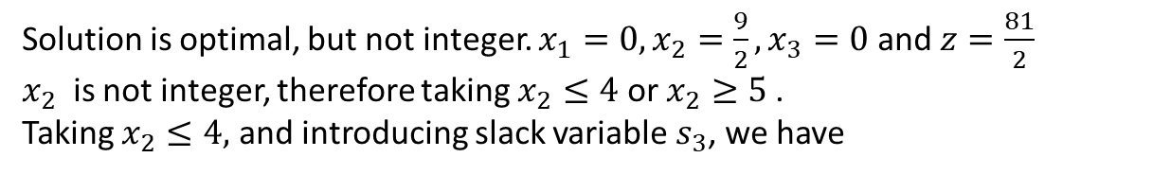
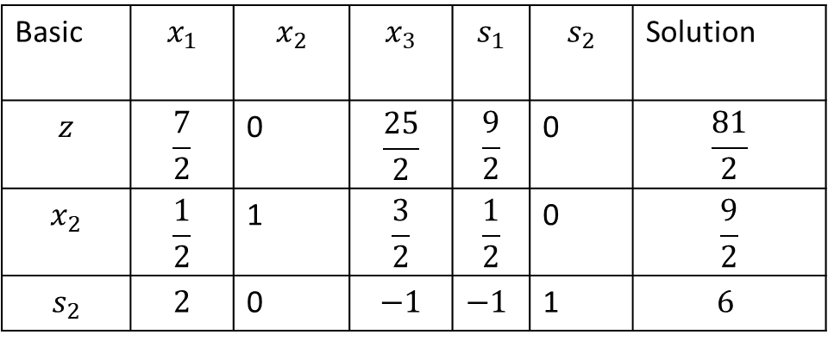
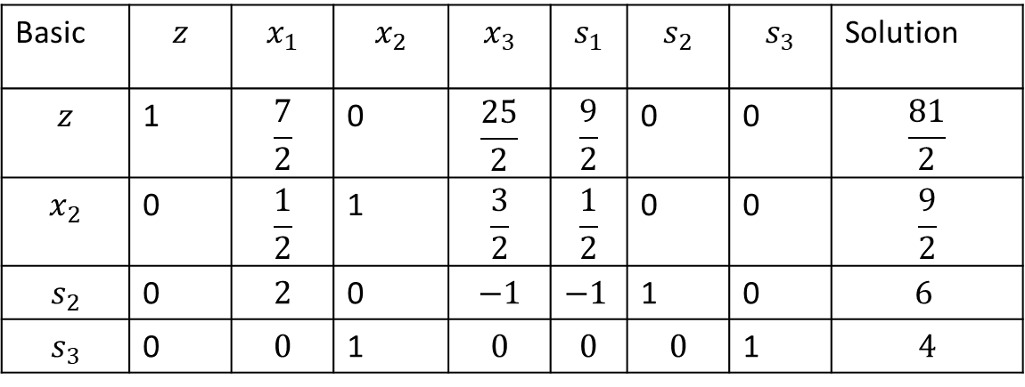
Basic | $$x_{1}$$ | $$x_{2}$$ | $$x_{3}$$ | $$s_{1}$$ | $$s_{2}$$ | Solution
$$z$$ | $$\frac{7}{2}$$ | 0 | $$\frac{25}{2}$$ | $$\frac{9}{2}$$ | 0 | $$\frac{81}{2}$$
$$x_{2}$$ | $$\frac{1}{2}$$ | 1 | $$\frac{3}{2}$$ | $$\frac{1}{2}$$ | 0 | $$\frac{9}{2}$$
$$s_{2}$$ | $$2$$ | 0 | $$−1$$ | $−1$ | 1 | $$6$$
Solution is optimal, but not integer. $x_{1}=0,x_{2}=\frac{9}{2},x_{3}=0$ and $z=\frac{81}{2}$
$x_{2}$ is not integer, therefore taking $x_{2}≤4$ or $x_{2}≥5$.
Taking $x_{2}≤4,$ and introducing slack variable $s_{3}$, we have
Basic | $$z$$ | $$x_{1}$$ | $$x_{2}$$ | $$x_{3}$$ | $$s_{1}$$ | $$s_{2}$$ | $$s_{3}$$ | Solution
$$z$$ | 1 | $$\frac{7}{2}$$ | 0 | $$\frac{25}{2}$$ | $$\frac{9}{2}$$ | 0 | 0 | $$\frac{81}{2}$$
$$x_{2}$$ | 0 | $$\frac{1}{2}$$ | 1 | $$\frac{3}{2}$$ | $$\frac{1}{2}$$ | 0 | 0 | $$\frac{9}{2}$$
$$s_{2}$$ | 0 | $$2$$ | 0 | $$−1$$ | $−1$ | 1 | 0 | $$6$$
$$s_{3}$$ | 0 | $$0$$ | 1 | $$0$$ | $$0$$ | $$0$$ | 1 | $$4$$
$x_{2}$ column is not unit vector, so subtracting $x_{2}$ row from $s_{3}$ row , we get

Slide 24
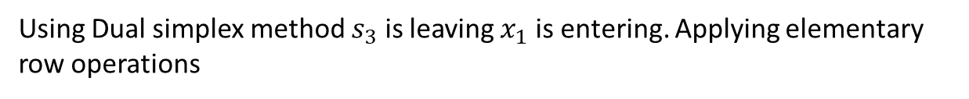
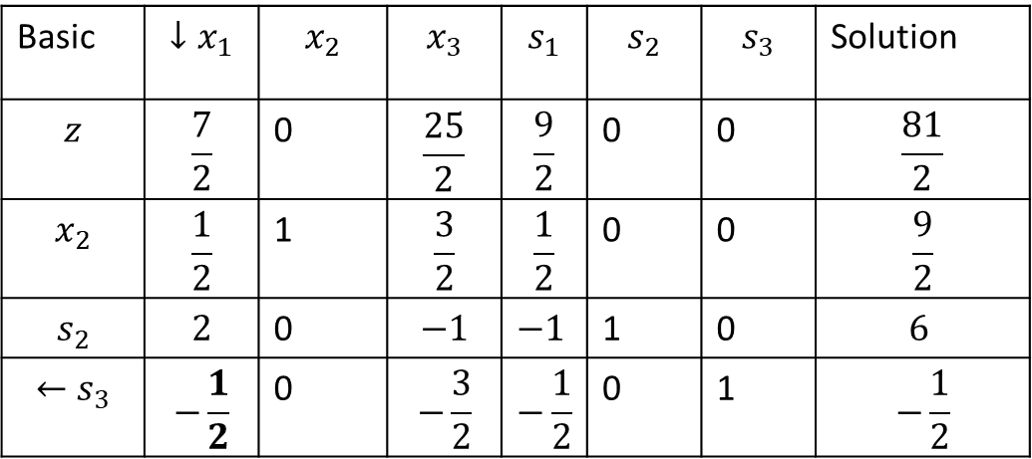
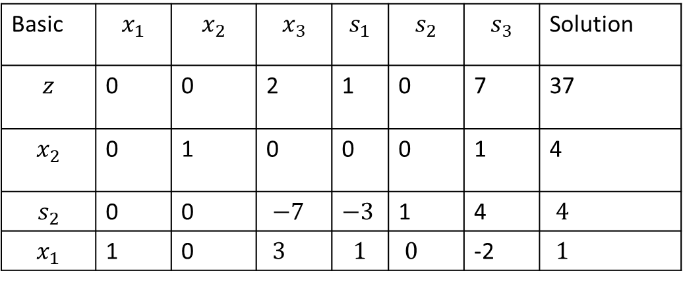
Basic | $$↓x_{1}$$ | $$x_{2}$$ | $$x_{3}$$ | $$s_{1}$$ | $$s_{2}$$ | $$s_{3}$$ | Solution
$$z$$ | $$\frac{7}{2}$$ | 0 | $$\frac{25}{2}$$ | $$\frac{9}{2}$$ | 0 | 0 | $$\frac{81}{2}$$
$$x_{2}$$ | $$\frac{1}{2}$$ | 1 | $$\frac{3}{2}$$ | $$\frac{1}{2}$$ | 0 | 0 | $$\frac{9}{2}$$
$$s_{2}$$ | $$2$$ | 0 | $$−1$$ | $−1$ | 1 | 0 | $$6$$
$$←s_{3}$$ | $$−\frac{1}{2}$$ | 0 | $$−\frac{3}{2}$$ | $$−\frac{1}{2}$$ | 0 | 1 | $$−\frac{1}{2}$$
Using Dual simplex method $s_{3}$ is leaving $x_{1}$ is entering. Applying elementary row operations
Basic | $$x_{1}$$ | $$x_{2}$$ | $$x_{3}$$ | $$s_{1}$$ | $$s_{2}$$ | $$s_{3}$$ | Solution
$$z$$ | 0 | 0 | 2 | 1 | 0 | 7 | 37
$$x_{2}$$ | 0 | 1 | 0 | 0 | 0 | 1 | 4
$$s_{2}$$ | 0 | 0 | $−7$ | $−3$ | 1 | 4 | $4$
$$x_{1}$$ | 1 | 0 | $3$ | $$1$$ | $0$ | -2 | $1$

Slide 25
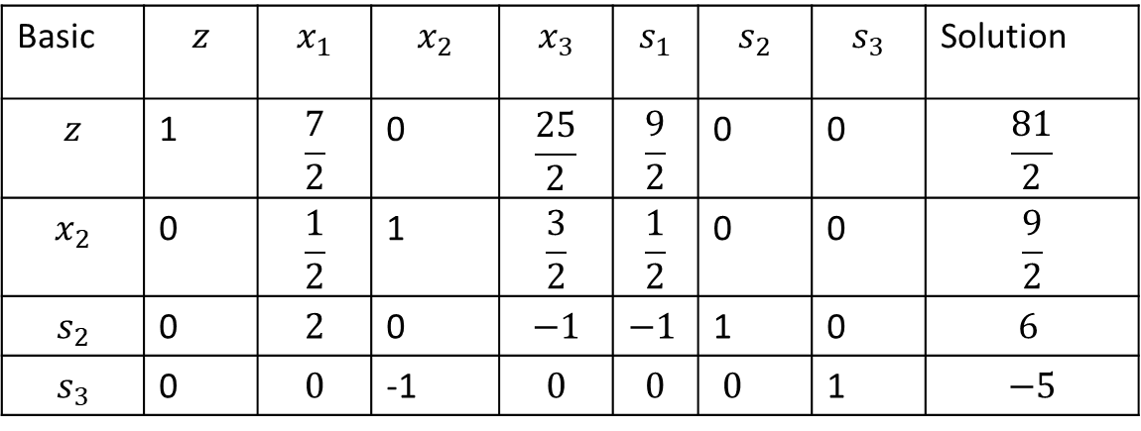
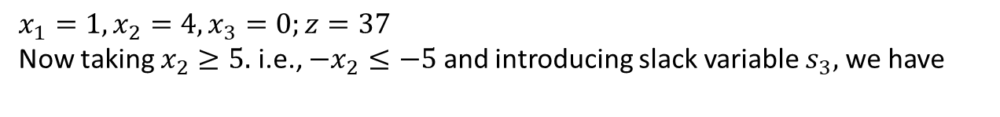
$x_{1}=1,x_{2}=4,x_{3}=0;z=37$
Now taking $x_{2}≥5.$ i.e., $−x_{2}≤−5$ and introducing slack variable $s_{3},$ we have
Basic | $$z$$ | $$x_{1}$$ | $$x_{2}$$ | $$x_{3}$$ | $$s_{1}$$ | $$s_{2}$$ | $$s_{3}$$ | Solution
$$z$$ | 1 | $$\frac{7}{2}$$ | 0 | $$\frac{25}{2}$$ | $$\frac{9}{2}$$ | 0 | 0 | $$\frac{81}{2}$$
$$x_{2}$$ | 0 | $$\frac{1}{2}$$ | 1 | $$\frac{3}{2}$$ | $$\frac{1}{2}$$ | 0 | 0 | $$\frac{9}{2}$$
$$s_{2}$$ | 0 | $$2$$ | 0 | $$−1$$ | $−1$ | 1 | 0 | $$6$$
$$s_{3}$$ | 0 | $$0$$ | -1 | $$0$$ | $$0$$ | $0$ | 1 | $$−5$$
Now $x_{2}$ column is not unit vector, so adding $x_{2}$- row to $s_{2}$-row, we get

Slide 26
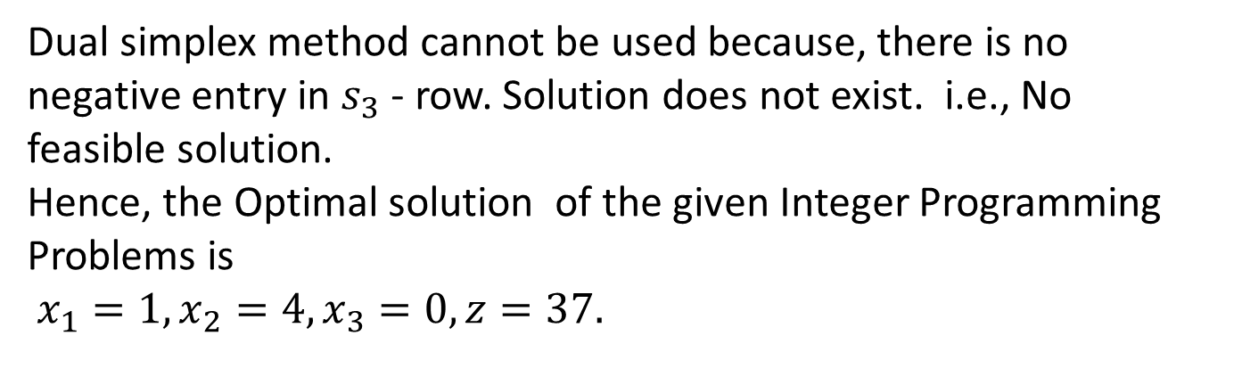
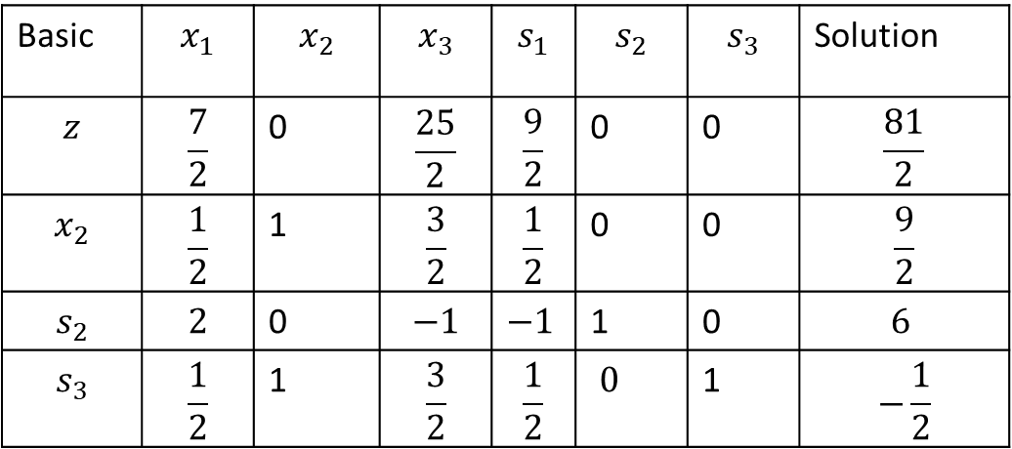
Basic | $$x_{1}$$ | $$x_{2}$$ | $$x_{3}$$ | $$s_{1}$$ | $$s_{2}$$ | $$s_{3}$$ | Solution
$$z$$ | $$\frac{7}{2}$$ | 0 | $$\frac{25}{2}$$ | $$\frac{9}{2}$$ | 0 | 0 | $$\frac{81}{2}$$
$$x_{2}$$ | $$\frac{1}{2}$$ | 1 | $$\frac{3}{2}$$ | $$\frac{1}{2}$$ | 0 | 0 | $$\frac{9}{2}$$
$$s_{2}$$ | $$2$$ | 0 | $$−1$$ | $−1$ | 1 | 0 | $$6$$
$$s_{3}$$ | $$\frac{1}{2}$$ | 1 | $$\frac{3}{2}$$ | $$\frac{1}{2}$$ | $0$ | 1 | $$−\frac{1}{2}$$
Dual simplex method cannot be used because, there is no negative entry in $s_{3}$ - row. Solution does not exist. i.e., No feasible solution.
Hence, the Optimal solution of the given Integer Programming Problems is
$x_{1}=1,x_{2}=4,x_{3}=0,z=37.$

Slide 27




Branch and Bound Chart
$$x_{1}=0,x_{2}=\frac{9}{2},$$
$$x_{3}=0;z=\frac{81}{2}$$
$$x_{2}≤4$$
$$x_{2}≥5$$
$$x_{1}=1,x_{2}=4,x_{3}=0;z=37$$
No feasible solution

Slide 28
Solve the following problem by Branch and Bound Method
Maximize z = x₁ + x₂
subject to 3x₁ + 2x₂ ≤ 12 x₂ ≤ 2
x₁, x₂ are integers ≥ 0
Solution.
First, we solve the above problem by applying the simplex method.
After introducing slack variables, we have 3x₁ + 2x₂ + x₃ = 12 x₂ + x₄ = 2
where x₃ and x₄ are slack variables.
Initial basic feasible solution
x₁ = 0, x₂ = 0, and z = 0 x₃ = 12, x₄ = 2

Slide 29
Final Table
 | c_{j} | 1 | 1 | 0 | 0
c_{B} | Basic variables B | x₁ | x₂ | x₃ | x₄ | Solution values b (=X_{B})
1 | x₁ | 1 | 0 | 1/3 | -2/3 | 8/3
1 | x₂ | 0 | 1 | 0 | 1 | 2
z_{j}–c_{j} |  | 0 | 0 | 1/3 | 1/3

Slide 30
x₁ = 8/3
x₂ = 2
Since the solution obtained is not an integer solution, we choose
x₁ = 8/3 (2 + 2/3),
which has a fractional value and divide the problem into the following two sub-problems (problem - II and problem - III) by adding two new constraints
x₁ ≤ 2
x₁ ≥ 3
because [x₁] = [2 + 2/3] = 2.

Slide 31
Problem – II
Maximize z = x₁ + x₂
subject to 3x₁ + 2x₂ ≤ 12 x₂ ≤ 2 x₁ ≤ 2
x₁, x₂ ≥ 0
Introducing slack variables
3x₁ + 2x₂ + x₅ = 12 x₂ + x₆ = 2 x₁ + x₇ = 2
where x_{5,} x₆ and x₇ are slack variables.

Slide 32
Final Table
 | c_{j} | 1 | 1 | 0 | 0 | 0
c_{B} | Basic variables B | x₁ | x₂ | x₅ | x₆ | x₇ | Solution values b (=X_{B})
0 | x₅ | 0 | 2 | 1 | 0 | -3 | 6
1 | x₂ | 0 | 1 | 0 | 1 | 0 | 2
1 | x₁ | 1 | 0 | 0 | 0 | 1 | 2
z_{j}–c_{j} |  | 0 | 0 | 0 | 1 | 1
Optimal solution to problem - II is x₁ = 2, x₂ = 2
Since all the variables in problem - II are integer valued, there is no need to branch this problem further.

Slide 33
Problem - III
Maximize z = x₁ + x₂
subject to 3x₁ + 2x₂ ≤ 12 x₂ ≤ 2 x₁ ≥ 3
x₁, x₂ ≥ 0
We use the two phase method to solve this problem.
Introducing slack, surplus & artificial variables
3x₁ + 2x₂ + x₈ = 12 x₂ + x₉ = 2 x₁ - x₁₀ + A₁ = 3
where: x₈ and x₉ are slack variables. x₁₀ is a surplus variable. A₁ is an artificial variable.

Slide 34
Final Table
 | c_{j} | 1 | 1 | 0 | 0 | 0
c_{B} | Basic variables B | x₁ | x₂ | x₈ | x₉ | x₁₀ | Solution values b (=X_{B})
1 | x₂ | 0 | 1 | 1/2 | 0 | 3/2 | 3/2
0 | x₉ | 0 | 0 | -1/2 | 1 | -3/2 | 1/2
1 | x₁ | 1 | 0 | 0 | 0 | -1 | 3
z_{j}–c_{j} |  | 0 | 0 | 1/2 | 0 | 1/2
x₁=3,x₂=3/2
The solution obtained is not integer valued.
Since [x₂] = [1 + 1/2] = 1,
we divide the problem - III into two parts by adding two new constraints
x₂ ≤ 1
x₂ ≥ 2
Thus, we form two sub-problems (problem - IV and problem - V).

Slide 35
Problem - IV
Maximize z = x₁ + x₂
subject to 3x₁ + 2x₂ ≤ 12 x₂ ≤ 2 x₁ ≥ 3 x₂ ≤ 1
x₁, x₂ ≥ 0
We use the two phase method to solve this problem.
Introducing slack, surplus & artificial variables
3x₁ + 2x₂ + x₁₁ = 12 x₂ + x₁₂ = 2 x₁ - x₁₃ + A₁ = 3 x₂ + x₁₄ = 1
where: x₁₁, x₁₂ & x₁₄ are slack variables. x₁₃ is a surplus variable. A₁ is an artificial variable.

Slide 36
Final Table
 | c_{j} | 1 | 1 | 0 | 0 | 0 | 0
c_{B} | Basic variables B | x₁ | x₂ | x₁₁ | x₁₂ | x₁₃ | x₁₄ | Solution values b (=X_{B})
0 | x₁₃ | 0 | 0 | 1/3 | 0 | 1 | -2/3 | 1/3
0 | x₁₂ | 0 | 0 | 0 | 1 | 0 | -1 | 1
1 | x₁ | 1 | 0 | 1/3 | 0 | 0 | -2/3 | 10/3
1 | x₂ | 0 | 1 | 0 | 0 | 0 | 1 | 1
z_{j}–c_{j} |  | 0 | 0 | 1/3 | 0 | 0 | 1/3
x₁ = 10/3
x₂ = 1

Slide 37
Problem - V
Maximize z = x₁ + x₂
subject to 3x₁ + 2x₂ ≤ 12 x₂ ≤ 2 x₁ ≥ 3 x₂ ≥ 2
x₁, x₂ ≥ 0
The solution to problem - V is infeasible. So we will not consider this problem.
But the solution to problem to problem - IV is not integer valued.
Since
[x₁] = [3 + 1/3] = 3,
we divide the problem - IV into two parts by adding two new constraints
x₁ ≤ 3
x₁ ≥ 4
Thus, we form two sub-problems (problem - VI and problem - VII).

Slide 38
Problem - VI
Maximize z = x₁ + x₂
subject to 3x₁ + 2x₂ ≤ 12 x₂ ≤ 2 x₁ ≥ 3 x₂ ≤ 1 x₁ ≤ 3
x₁, x₂ ≥ 0
Introducing slack, surplus & artificial variables
3x₁ + 2x₂ + x₁₅ = 12 x₂ + x₁₆ = 2 x₁ - x₁₇ + A₁ = 3 x₂ + x₁₈ = 1 x₁ + x₁₉ = 3
where: x₁₅, x₁₆, x₁₈ and x₁₉ are slack variables. x₁₇ is a surplus variable. A₁ is an artificial variable.

Slide 39
Final Table
 | c_{j} | 1 | 1 | 0 | 0 | 0 | 0 | 0
c_{B} | Basic variables B | x₁ | x₂ | x₁₅ | x₁₆ | x₁₇ | x₁₈ | x₁₉ | Solution values b (=X_{B})
0 | x₁₅ | 0 | 2 | 1 | 0 | 0 | 0 | -3 | 3
0 | x₁₆ | 0 | 1 | 0 | 0 | 0 | 0 | -1 | 2
1 | x₁ | 1 | 0 | 0 | 0 | 0 | 0 | 1 | 3
0 | x₁₈ | 0 | 1 | 0 | 0 | 0 | 1 | 0 | 1
0 | x₁₇ | 0 | 0 | 0 | 0 | 1 | 0 | 1 | 0
z_{j}–c_{j} |  | 0 | 0 | 0 | 0 | 0 | 0 | 1
This problem has multiple optimal solution. As x₂ is zero, it enters into the basis.
The optimal solution is x₁ = 3
x₂ = 1 Since all the variables in problem - VI are integer valued, there is no need to branch this problem further.

Slide 40
Problem - VII
Maximize z = x₁ + x₂
subject to 3x₁ + 2x₂ ≤ 12 x₂ ≤ 2 x₁ ≥ 3 x₂ ≤ 1 x₁ ≥ 4
x₁, x₂ ≥ 0
Introducing slack, surplus & artificial variables
3x₁ + 2x₂ + x₂₀ = 12 x₂ + x₂₁ = 2 x₁ - x₂₂ + A₁ = 3 x₂ + x₂₃ = 1 x₁ - x₂₄ + A₂ = 4
where: x₂₀, x₂₁ and x₂₃ are slack variables. x₂₂ and x₂₄ are surplus variables. A₁ and A₂ are artificial variables

Slide 41
Final Table
 | c_{j} | 1 | 1 | 0 | 0 | 0 | 0 | 0
c_{B} | Basic variables B | x₁ | x₂ | x₂₀ | x₂₁ | x₂₂ | x₂₃ | x₂₄ | Solution values b (=X_{B})
1 | x₂ | 0 | 1 | 1/2 | 0 | 0 | 0 | 3/2 | 0
0 | x₂₁ | 0 | 0 | -1/2 | 1 | 0 | 0 | -3/2 | 2
1 | x₁ | 1 | 0 | 0 | 0 | 0 | 0 | -1 | 4
0 | x₂₃ | 0 | 0 | -1/2 | 0 | 0 | 1 | -3/2 | 1
0 | x₂₂ | 0 | 0 | 0 | 0 | 1 | 0 | -1 | 1
z_{j}–c_{j} |  | 0 | 0 | 1/2 | 0 | 0 | 0 | 1/2
The optimal solution is x₁ = 4
x₂ = 0
Since all the variables in problem - VII are integer valued, there is no need to branch this problem further.

Slide 42
The history of the complete branch and bound solution is displayed by means of the following tree like diagram.

Slide 43
Example 4
Minimize Z=3x₁+ 2.5x₂
subject to
x₁+2x₂ ≥ 20
3x₁+2x₂ ≥ 50
x₁ , x₂ ≥ 0 and are integers

Slide 44
The history of the complete branch and bound solution is displayed by means of the following tree like diagram.
X₁=15, X₂=2.5, Z₁=51.25
X₁=16, X₂=2, Z₂=53
X₁=14.66, X₂=3, Z₃=51.5
X₁=14, X₂=4, Z₄=52
X₁=15, X₂=4, Z₄=52.5
B
x₂ ≤ 2
A
D
X₂ ≥ 3
C
X₁ ≤14
Optimal solution
E
x₁≥15

